Slide 1
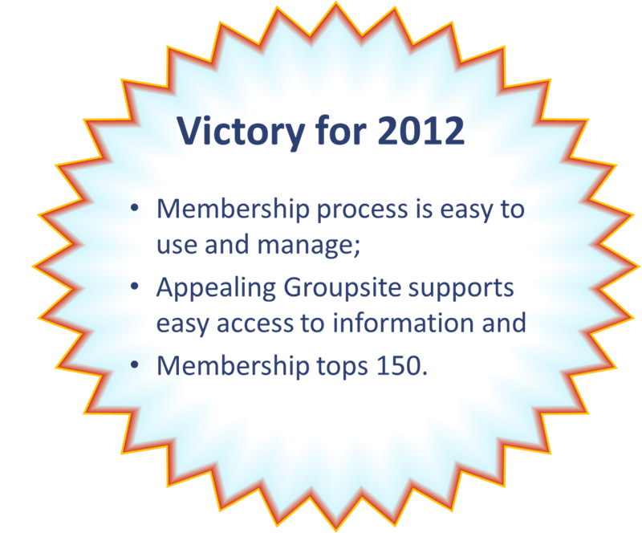
2012 Membership Action Team

Slide 2
Bookkeeper is Daryl Hodges
Check may be without form – who is this person?
May not be opened timely
May not be sent
Entry may reflect payer, not member
How easy is it to find the form when the person is motivated to act?
Bookkeeper records payment in Quickbooks
Bookkeeper sends form to EMC/SW
Have Mbr-ship form?
Is form received timely?
Does mbr respond?
Decision to join
Fill it out and send to CFO
Create Groupsite record & issue invite
Groupsite record completed
Y
Y
Y
N
N
N
Know where to look?
Is some one looking for it?
Find the form
Form located & properly forwarded
Follow up contact made
Y
Y
Member may not understand how to use
May not engage
N
N
Does mbr respond?
Ask for help
No action taken
N
N
Is help provided?
Person not served well
Not impressed with Network
Up to applicant to raise questions
Y
No activity
N
Hard to connect with the Network
Member likely to not engage
Frustrated
Person not served well
May stop effort
Not impressed with Network
ENROLLING A NEW MEMBER – OLD PROCESS

Slide 3
Public facing website with information about ToP Network. ToP course grads can sign up to keep informed without having to join ToP. This provides a marketing tool for conferences.
Website records payment
Click on “Join Us” link at www.top-network.org
Application form opens. Applicant enters information online.
Are membership criteria met?
Payment window opens to pay online.
Was payment completed?
Decision to join
Y
Y
N
N
Website notes unmet criteria and provides an option to receive a call back
Website generates email with instructions for completing payment
New member application process includes requirement for TFM and commitment to proper use of ToP Methods. Enrollment is automatic
to
Website sends renewal reminder 90, 60, 30 days before due date
Report issued to MAT for follow up with new member for Mentor matching , etc.
Relevant information displays with further instructions
Are preferences entered?
Member profile opens to solicit more information
Website generates receipt. Opens member portal and activates discounts
Y
N
Receipt generated. Membership status continues
Are dues paid?
This area needs continued work
Renewal notices and termination for nonpayment is automated.
Outreach keeps new members from getting lost in the system
Y
N
Access to member portal and benefits terminates.
ENROLLING/MAINTAINING MEMBERS – NEW PROCESSES

Slide 4
WHAT DID MAT DO IN 2012?
Followed up with 50+ unrenewed members
Designed new processes with better flow
Reconciled membership history to ID non renewed members
Investigated technology options that might work for us
Drafted membership policies for board action
Analyzed old processes to identify breakdowns
first committee to shift work to
top-network.org
Began process of interviewing new members
Closed 2012 with
129 ToP Network members!
Provided input into web navigation decisions
Jumped in first to test new processes and provide feedback
Began to analyze web traffic

Slide 5
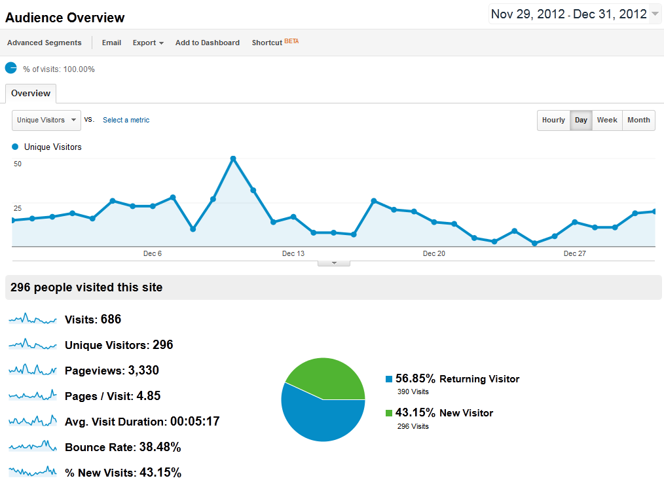
Daily Visitors (Unique Visitors)
Early Bird Rate Ends Dec 10
50 unique visitors this day
Started tracking web traffic
Those using multiple browsers would be counted for each one

Slide 6
Coming soon:
top-network.org’s
new public face
HOME | MEMBERS | COURSES | FAQ | CONTACT US | ABOUT US

